Slide 1
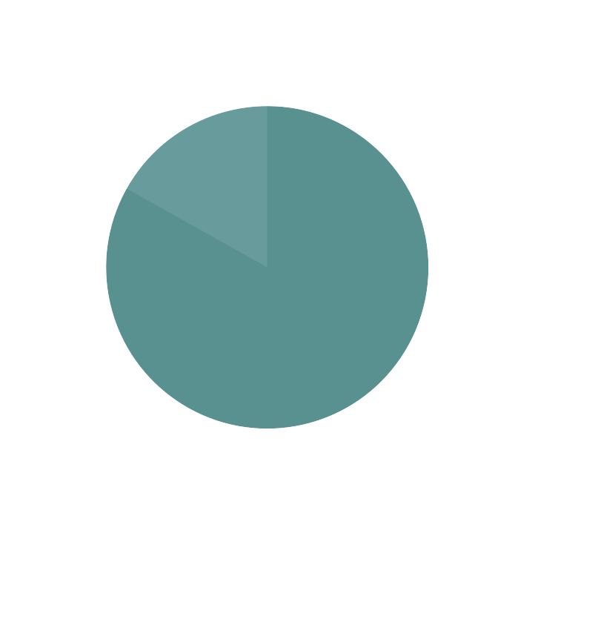



PROJECT PHASE -1
Team No
Team Members Guide Department University
: 10
: Swathi B (ENG21CT0042) , S A Sharan Veronica (ENG21CT0035)
: Prof.Vinayaka V M
: Computer Science & Technology
: Dayananda Sagar University

Slide 2
AI-Enhanced Cloud-Based Mental Health Support Platform for Students: Integrating Real-Time Mood Tracking, Personalized Interventions and Interactive Relaxation Games

Slide 3
INDEX
Abstract
Introduction
Literature Survey
Research Gap
Problem Statement
Proposed Methodology
Road Map
Conclusion
References

Slide 4
Abstract
This project aims to develop a cloud-based mental health support platform that integrates AI-driven real-time mood tracking with personalized interventions for students. Using emotion detection and predictive algorithms, the platform suggests interactive relaxation games to improve student's emotional well-being.
Key Components:
Real-time emotion tracking
AI-based mood prediction
Personalized support and recommendations
Relaxation games integration

Slide 5
Introduction
Context:
Mental health issues among students are increasing due to academic pressure and social challenges. A digital platform providing timely emotional support can help address these problems.
Objective:
To develop a platform that detects students' emotional states and offers personalized interventions in real-time using AI technologies.
Importance:
This helps tackle mental health issues by promoting healthier ways to handle stress.

Slide 6
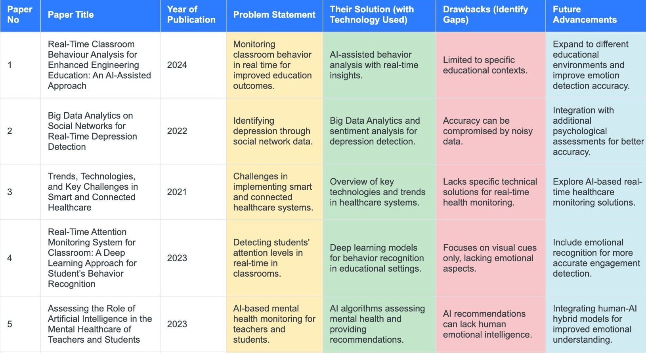
Literature Survey

Slide 7
Real-time analytics dashboard for emotion dete‹:ation using affective œmputing.
A Real-Time Learning Analytics Dashboard for Automatic Detection of Online Leamers'Affective States
Monitoring leamers' affective states during online Learning.
Extend applicability to broader e-leasing platforms and hybrid models.
Limited to specific online leaming erivironmenb.
6
2023
Facial emotion recognition based real- time learner engagement detection system in online learning context using deep learning models
DeteMng leamer engagement through facial emotion recognition in online leaming.
Dose not acœunt for environmental distracêons or engagement fluctuations.
Inœrpoæte environmental factors and ^{enga}_{e}^{ement}shifts for real-time adjustmenB.
Dasp leaming models for facial emotion recognition.
7
2022
Using sentiment analysis to evaluate qualitative students' responses
Evaluating students' responses using sentiment analysis techniques.
Sentiment analysis algorithms to determine the tone of responses.
May misinterpret neutral or ambiguous æ8pori6es.
Improve algorithms to handle nuanced and complex sentiments.
8
2022
Al-based adaptive personalized content presentation and exercises navigation for an effective and engaging E-learning platform
Providing personalized content for improved e-learning engagement.
Al-driven personalized œntent recommendations for æ leaming.
Refine algorithms to better match individual learner profiles and needs.
9
2022
May not adapt well to diverse leaming styles.
Experiences of Users with an Online Self-Guided Mental Health Training Program Using Gami5cation
Enhancing mental health programs through gami5œtion.
Integæte real-time feedback mechanisms for mental health tracking.
Self-gulded mental health programe with gamified elements.
Lacks æak8me monitoring of mental hœlth piogæss.
10
2023

Slide 8
Research Gap
Identified Gaps:
❏ Existing solutions don’t offer real-time interventions.
❏ Limited integration of AI for emotion prediction and gaming.
❏ No comprehensive platform that combines tracking, personalized interventions and stress-relief games.
A system that not only tracks mood but also recommends personalized interventions and interactive relaxation games based on real-time emotional shifts.

Slide 9

Problem Statement
Problem Statement: Enhancing student mental health
systems by integrating tracking through facial learning-based mood interactive support.
real-time engagement, mood emotion recognition, machine prediction, and personalized
Objective: Build an AI-enhanced cloud platform that tracks emotions and offers immediate, personalized interventions including relaxation games.

Slide 10
Proposed Methodology
Facial Emotion Recognition for Real-Time Mood Tracking:
Facial Expression Analysis: The platform utilizes computer vision to analyze student's facial expressions through webcams or mobile cameras identifying key emotions like happiness, sadness, anger, fear and stress.
Emotion Labels: The system assigns labels (e.g., happy, neutral, stressed) to indicate the student's current emotional state based on the analysis.
Machine Learning for Mood Prediction:
Data Collection: Historical mood data and behavioral factors are collected.
Pattern Learning: ML algorithms analyze time-series data to identify trends and detecting moods.
Mood Prediction: Using supervised learning models, the system predicts future emotional states based on past data.
Eg-(Recurrent Neural Networks (RNNs) or Long Short-Term Memory (LSTM))

Slide 11

Personalized Interventions and Recommendations:
AI-Driven Support: The platform recommends personalized interventions (e.g., relaxation games) based on real-time mood and predictions.
Relaxation Games: Interactive games are suggested to alleviate stress, tailored to the student's mood.
Continuous Feedback Loop: Real-time emotion monitoring adjusts interventions as needed.
Cloud Infrastructure and Deployment:
Cloud-Based Deployment - The platform will be fully deployed on the cloud, utilizing Amazon Web Services (AWS) to manage its infrastructure and functionality for seamless performance and scalability.

Slide 12

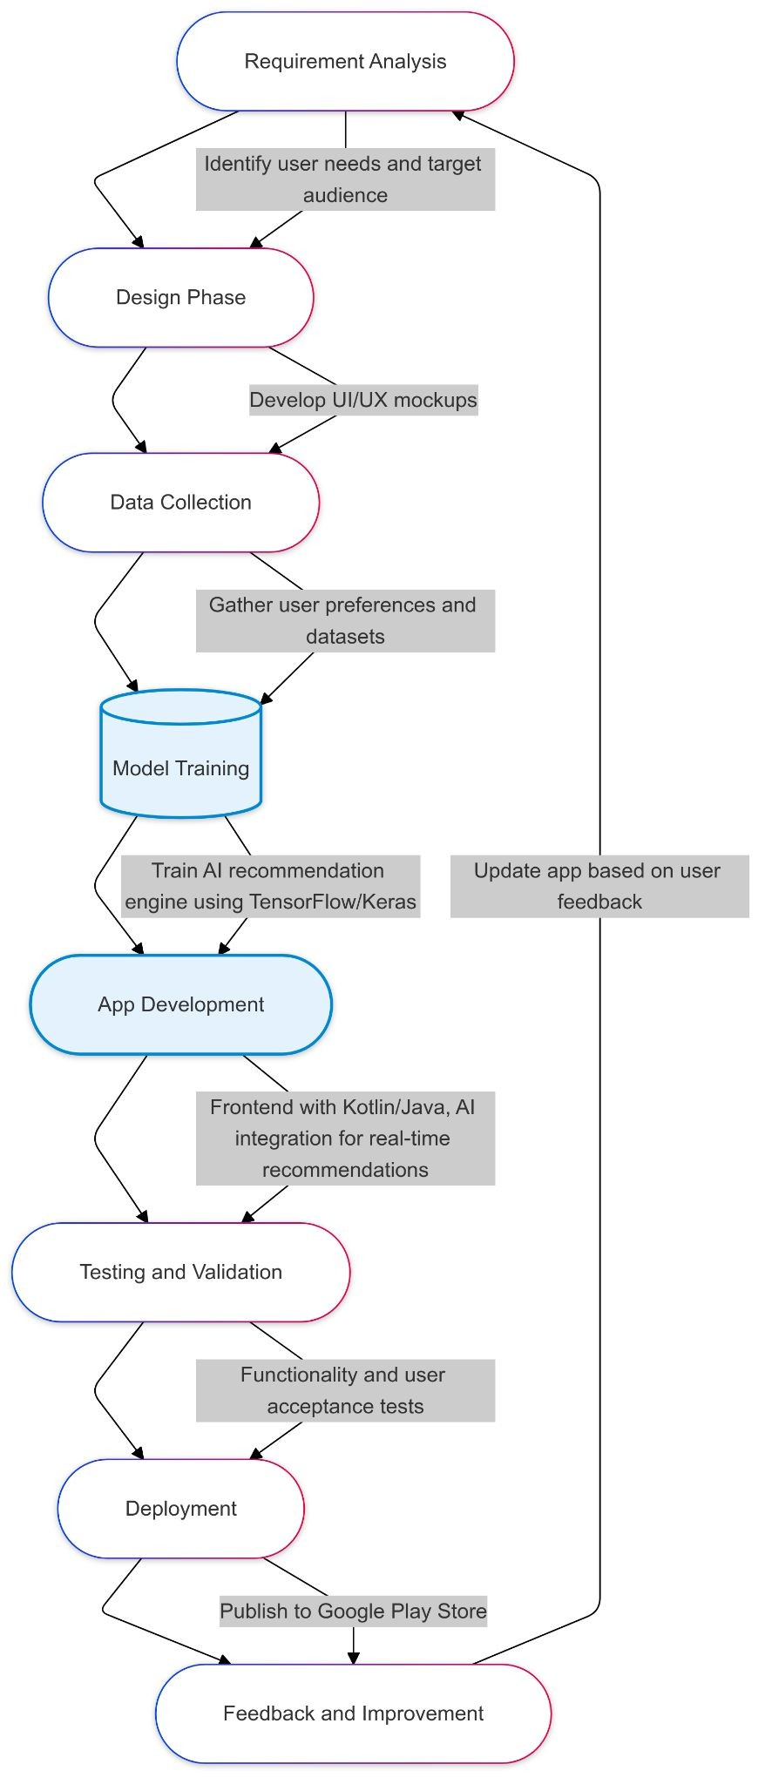

Slide 13
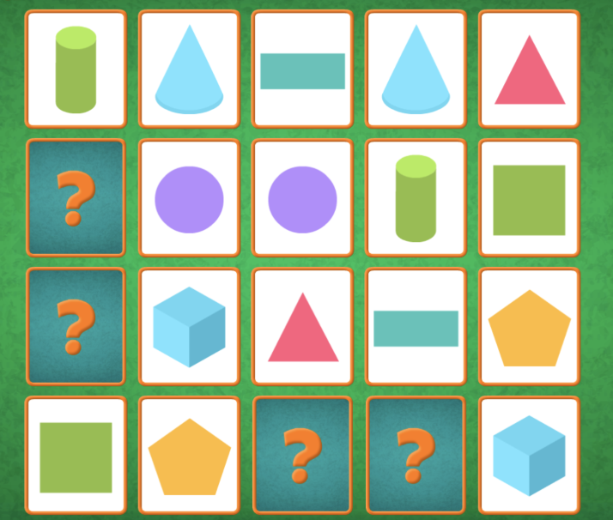
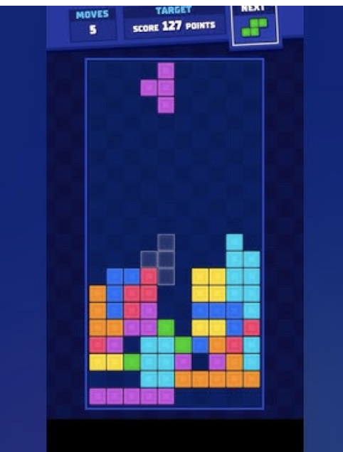
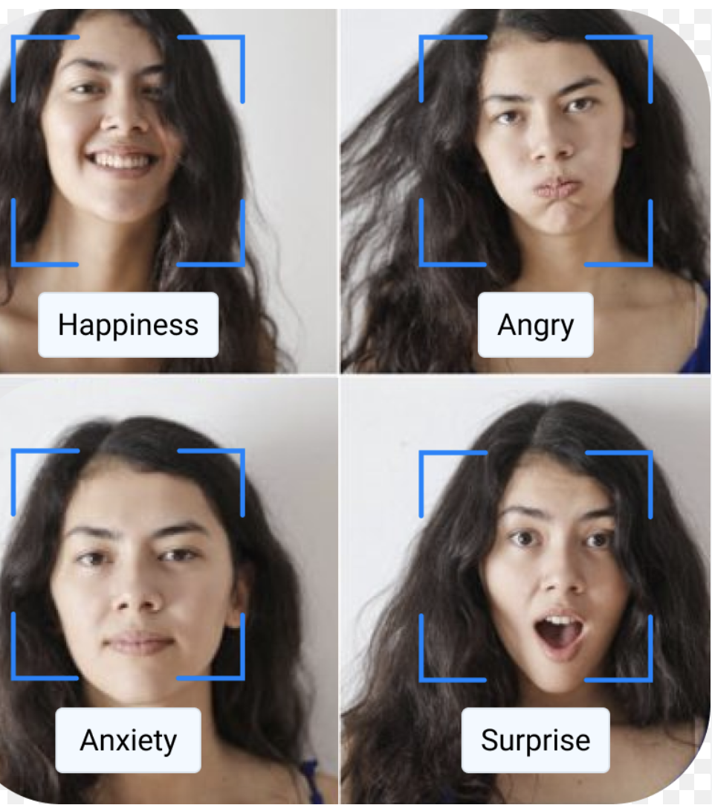
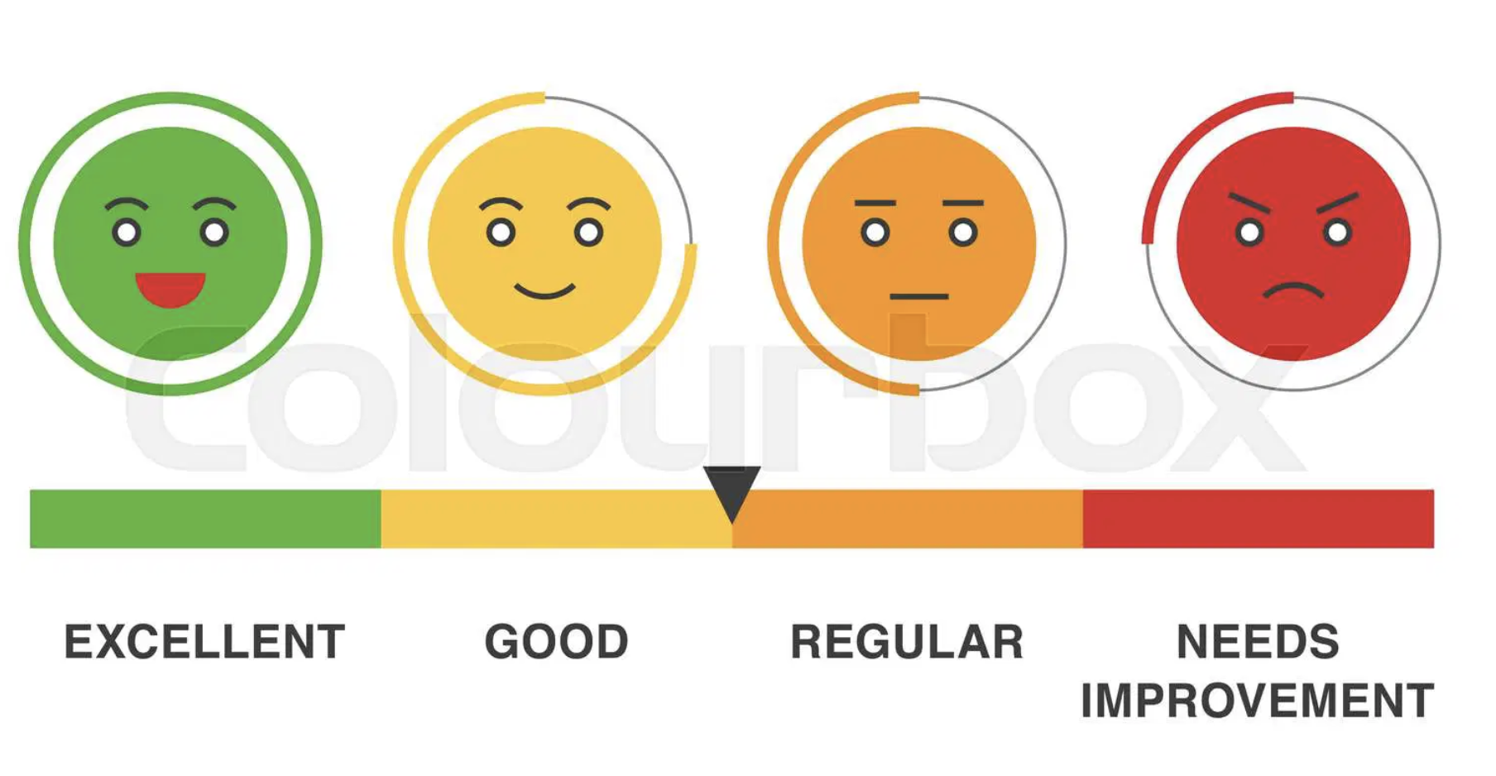
FEATURES INTEGRATED
Personalized Relaxation Games
Facial Emotion Recognition for Real-Time Mood Tracking
Pattern Learning

Slide 14


Slide 15
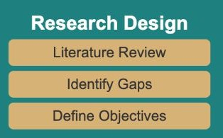
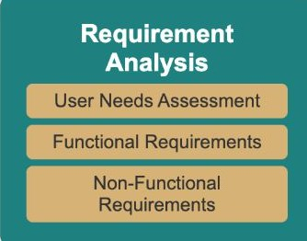
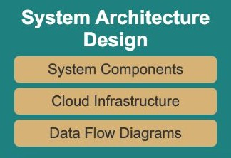
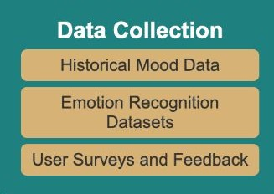
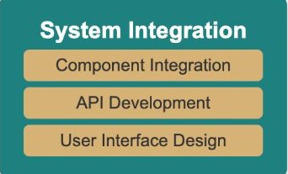
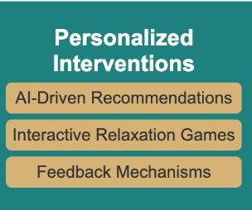
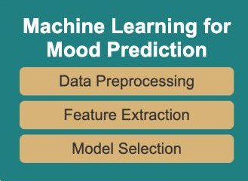
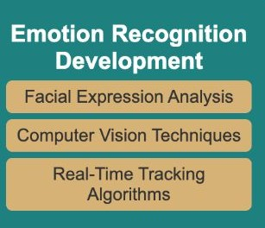
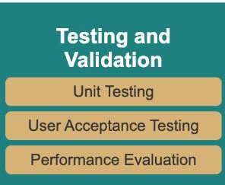
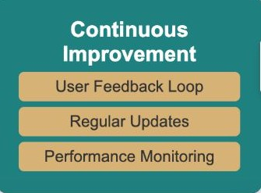
Roadmap
→
→
→
→
→
→
→
→
→

Slide 16
Conclusion
This AI-powered cloud platform delivers real-time emotional support to students helping reduce stress through facial emotion recognition, mood prediction and personalized interventions like relaxation games. By leveraging AI and cloud technologies, it offers scalable, continuous feedback, ensuring students receive timely and tailored support to improve their mental well-being.

Slide 17
References
Hu, J., Huang, Z., Li, J., Xu, L. and Zou, Y., 2024. Real-Time Classroom Behavior Analysis for Enhanced Engineering Education: An AI-Assisted Approach. International Journal of Computational Intelligence Systems, 17(1), p.167.
Angskun, J., Tipprasert, S. and Angskun, T., 2022. Big data analytics on social networks for real-time depression detection. Journal of Big Data, 9(1), p.69.
Navaz, A.N., Serhani, M.A., El Kassabi, H.T., Al-Qirim, N. and Ismail, H., 2021. Trends, technologies, and key challenges in smart and connected healthcare. Ieee Access, 9, pp.74044-74067.
Trabelsi, Z., Alnajjar, F., Parambil, M.M.A., Gochoo, M. and Ali, L., 2023. Real-time attention monitoring system for classroom: A deep learning approach for student’s behavior recognition. Big Data and Cognitive Computing, 7(1), p.48.
Lei, L., Li, J. and Li, W., 2023. Assessing the role of artificial intelligence in the mental healthcare of teachers and students. Soft Computing, pp.1-11.
Hasnine, M.N., Nguyen, H.T., Tran, T.T.T., Bui, H.T., Akçapınar, G. and Ueda, H., 2023. A real-time learning analytics dashboard for automatic detection of online learners’ affective states. Sensors, 23(9), p.4243.
Gupta, S., Kumar, P. and Tekchandani, R.K., 2023. Facial emotion recognition based real-time learner engagement detection system in online learning context using deep learning models. Multimedia Tools and Applications, 82(8), pp.11365-11394.
Dake, D.K. and Gyimah, E., 2023. Using sentiment analysis to evaluate qualitative students’ responses. Education and Information Technologies, 28(4), pp.4629-4647.
Sayed, W.S., Noeman, A.M., Abdellatif, A., Abdelrazek, M., Badawy, M.G., Hamed, A. and El-Tantawy, S., 2023. AI-based adaptive personalized content presentation and exercises navigation for an effective and engaging E-learning platform. Multimedia Tools and Applications, 82(3), pp.3303-3333.
van der Lubbe, L.M., Gerritsen, C., Klein, M.C., Rodgers, R.F. and Hindriks, K.V., 2023. Experiences of Users with an Online Self-Guided Mental Health Training Program Using Gamification. Journal of Healthcare Informatics Research, 7(2), pp.141-168.

Slide 18
THANK YOU

